Slide 1
Fake-News Detection

Slide 2






Slide 3

Group Members
Guide
DR. M ASHWIN
Shalini Das 19BAI10139
Shanzeh Batool 19BAI10017
Pranjal Roy 19BAI10008
Karan Jain 19BAI10095

Slide 4




Contents :-
INTRODUCTION
EXISTING WORK & LIMITATIONS
PROPOSED WORK & METHODOLOGIES
Passive_Aggressive_Classifier
CountVectorizer v/s TfidfVectorizer
NAIVE BAYES
SUPPORT VECTOR MACHINE
NEURAL NETWORKS
LONG SHORT TERM MEMORY (LSTM)
NOVELTY
REAL TIME USAGE
Who spreads fake news?
HARDWARE & SOFTWARE REQUIREMENTS
OVERALL SYSTEM ARCHITECTURE DIAGRAM
ReferenceS

Slide 5

INTRODUCTION
Defining fake news
Project’s objective

Slide 6

Defining fake news
Definition 1 (Broad definition of fake news): Fake news is false news.
Definition 2 (Narrow definition of fake news): Fake news is intentionally false news published by a news outlet.
Project’s Objective
Develop a machine learning model to detect fake news.
Use data analysis to train the model.
Classify the data into fake news and real news with the help of machine learning algorithms, neural networks.

Slide 7


EXISTING WORK & LIMITATIONS
Some already existing apps and their limitations:
Test news: Only functions when link is provided to it. Otherwise it says invalid for almost every news.
Fake finder: An AI fake news detection and filter that is developed by twitter and still being worked on. This AI however is centered only on one social media i.e twitter.
Newscope: Was a famous app but was not completely AI based. Now due to their lack of funds they have disabled expert reviews and the app has lost its accuracy and become biased.

Slide 8

PROPOSED WORK & METHODOLOGIES
Classification Models
{
Passive Aggressive
Naive Bayes
Support Vector Machine
Neural Network
Long Short Term Memory

Slide 9
Passive_Aggressive_Classifier
Passive Aggressive algorithms are online learning algorithms. Such an algorithm remains passive for a correct classification outcome, and turns aggressive in the event of a miscalculation, updating and adjusting. Unlike most other algorithms, it does not converge. Its purpose is to make updates that correct the loss, causing very little change in the norm of the weight vector.

Slide 10
TfidfVectorizer
😋
CountVectorizer
😉
What is TfidfVectorizer?
Term Frequency(Tf) — Inverse Document Frequency(Idf) Vectorizer is a common algorithm to transform text into meaningful representation of numbers. It is used to extract features from text strings based on occurrence.
What is CountVectorizer?
The CountVectorizer tokenizes the data and
then counts each term. The data can be tokenized by word or by n-gram. N-grams are series
of n items, such as words or characters.

Slide 11
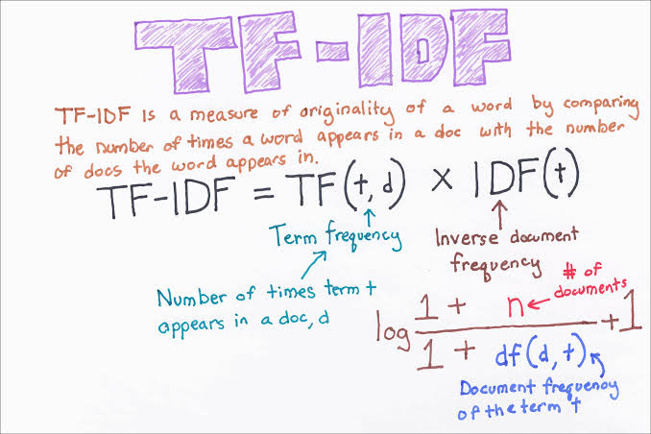
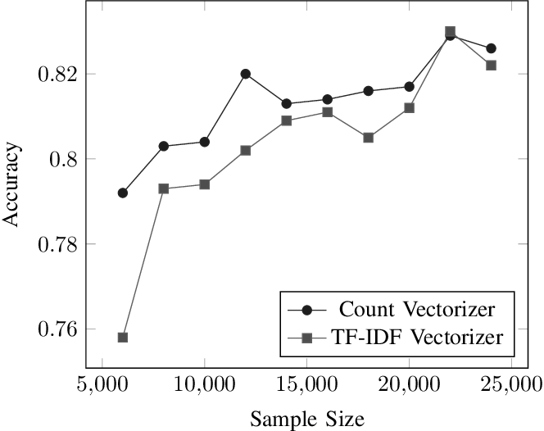

Slide 12
NAIVE BAYES
Module Flow
What is Naive Bayes?
Naive Bayes Algorithm
Advantages and Disadvantages

Slide 13
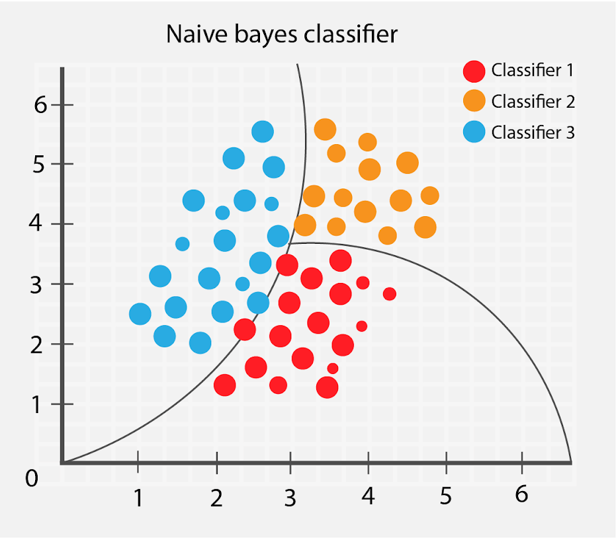
What is Naive Bayes?
The crux of this classifier is based on Bayes Theorem with the “naive” assumption of conditional between every pair of features given the value of the class variable.
Types of Naive Bayes:
Multinomial Naive Bayes
Bernoulli Naive Bayes
Gaussian Naive Bayes
Complement Naive Bayes
Categorical Naive Bayes

Slide 14
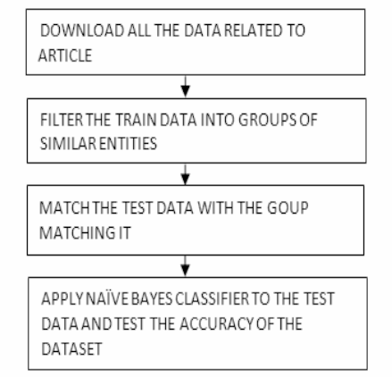
MODULE FLOW
Here weights are given to each and every individual word, the least important word is given less weight and most important word is given most weight. Also the tfidf vector is used to count the number of word and also the number of unique words is counted and at the same time the weights are allotted to each and every word.
In this way the unimportant words are not taken into consideration and the accuracy of only important words are matched and detected from the dataset, this saves the time to detect the accuracy of the news.

Slide 15

Class Prior Probability
Likelihood
Posterior
Probability
Predictor Prior Probability
(Evidence)

Slide 16
Advantages Simple, easy and fast. Not sensitive to irrelevant features. Works great in practice. Needs less training data. For both multiclass and binary classification. Works with continuous and discrete data. | Disadvantages Accepts every feature as independent. This is not always the truth.

Slide 17
Support vector machine
A support vector machine (SVM) is a supervised machine learning model that uses classification algorithms for two-group classification problems. After giving an SVM model sets of labeled training data for each category, they’re able to categorize new text.

Slide 18
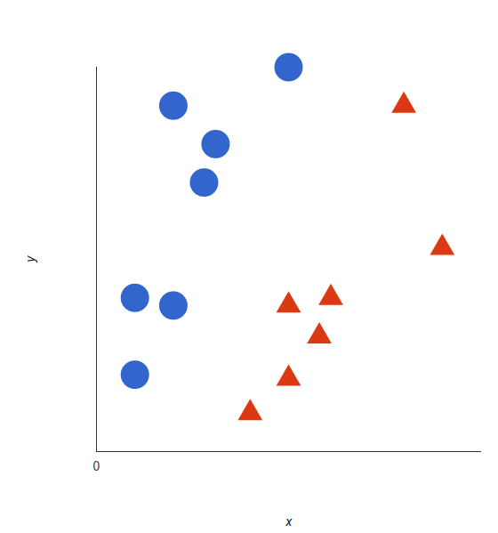
The basics of Support Vector Machines and how it works are best understood with a simple example. Let’s imagine we have two tags:red and blue, and our data has two features : x and y . We want a classifier that, given a pair of (x,y) coordinates, outputs if it’s either red or blue. We plot our already labeled training data on a plane:
A support vector machine takes these data points and outputs the hyperplane (which in two dimensions it’s simply a line) that best separates the tags. This line is the decision boundary: anything that falls to one side of it we will classify as blue, and anything that falls to the other as red.

Slide 19

NEURAL NETWORKs
A series of algorithms that recognize underlying relationships in a set of data.

Slide 20
Problem Formulation
We formulate the fake news detection problem as a credibility inference problem, where the real ones will have a higher credibility and unauthentic ones will have a lower one instead.
REPRESENTATION FEATURE LEARNING
CREDIBILITY LABEL INFERENCE
DEEP DIFFUSIVE NEURAL NETWORK

Slide 21
News Article
News Subject
News Creator
Textual content and Credibility label
News Augmented Heterogeneous Social Networks

Slide 22
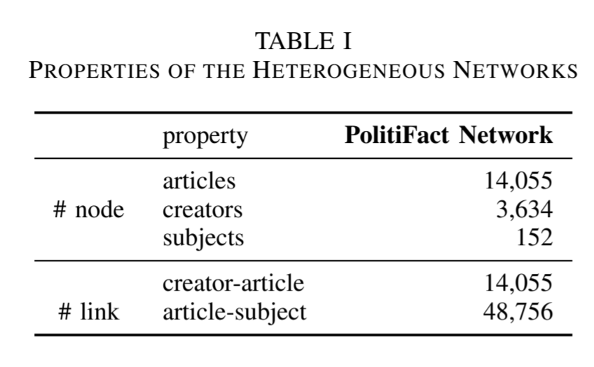
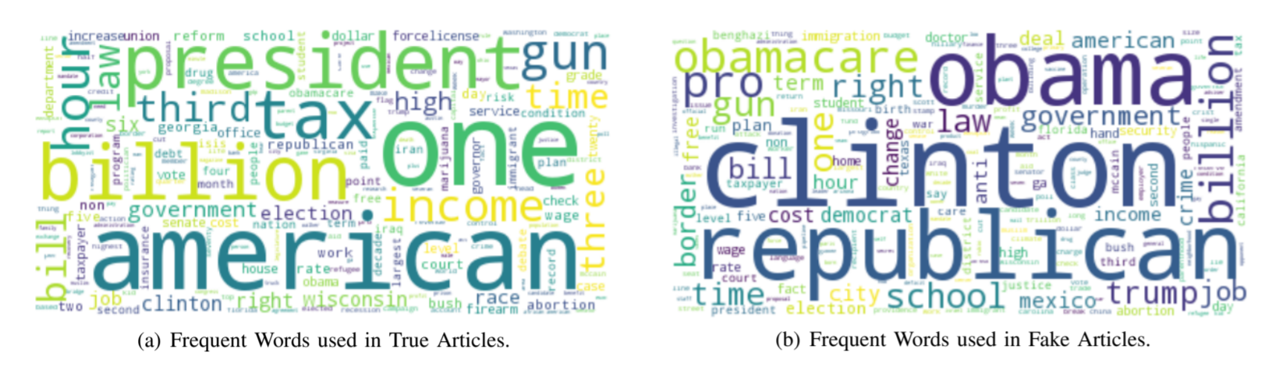
DATASET ANALYSIS
Dataset Statistical Information
Article Credibility Analysis with Textual Content
TRUE
FAKE

Slide 23
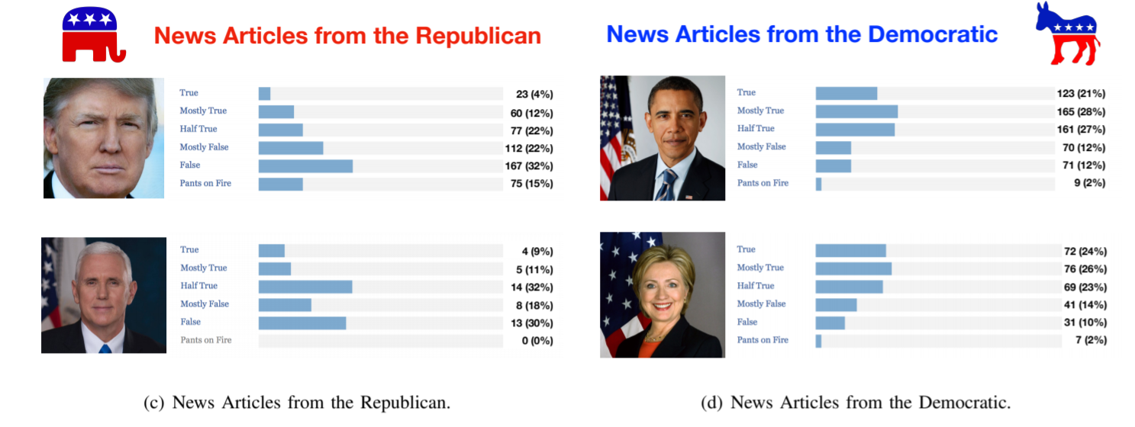
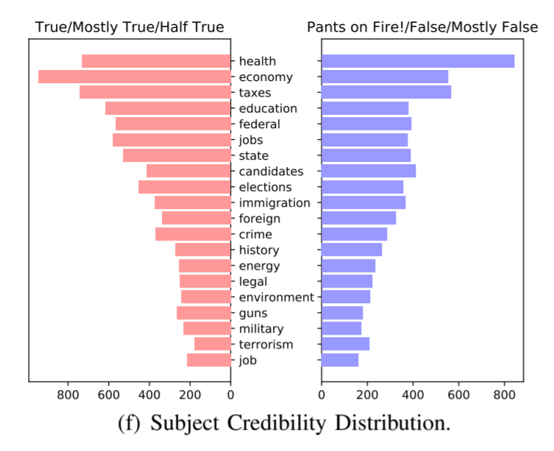
Creator Credibility Analysis
Subject Credibility Analysis

Slide 24
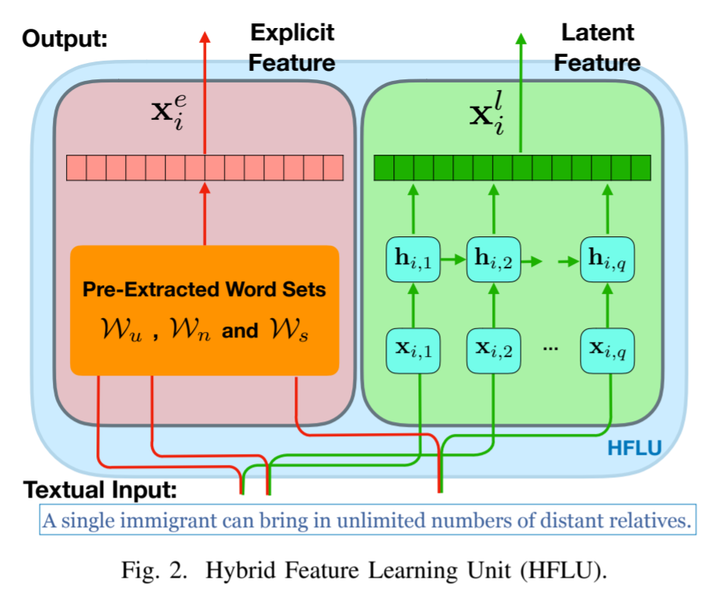
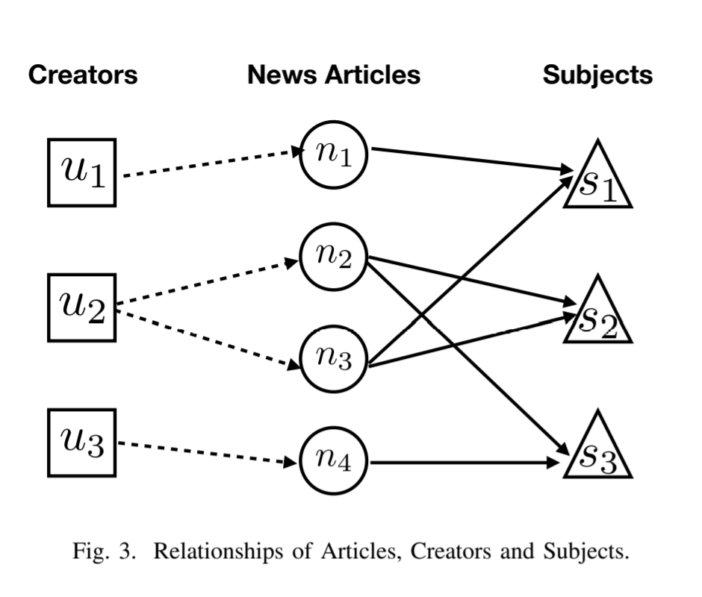
REPRESENTATION FEATURE LEARNING
RELATIONSHIP GRAPH

Slide 25
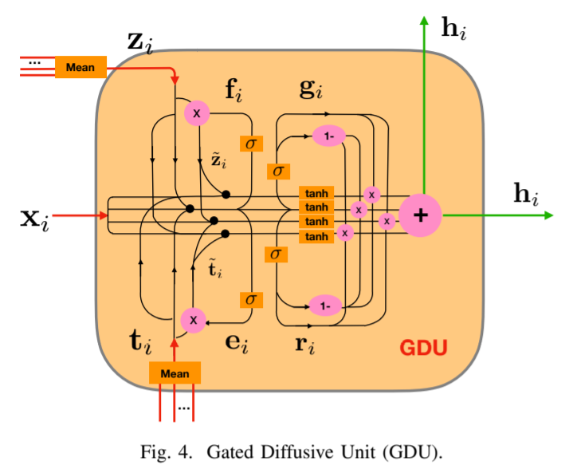
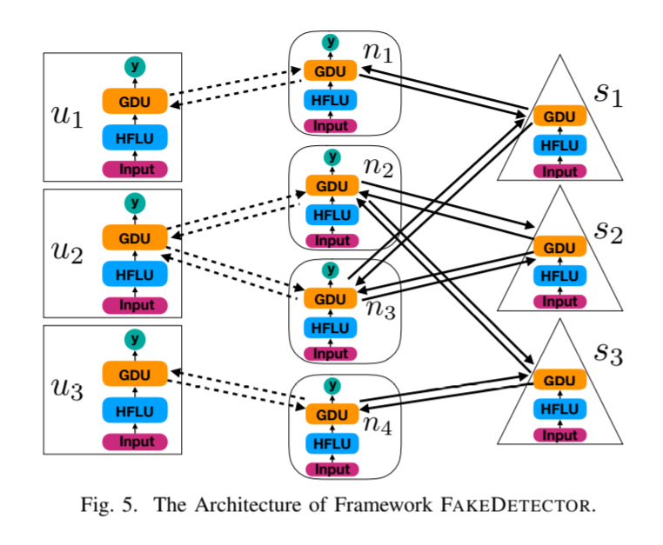
RELATIONSHIP MODELING
OVERALL MODEL ARCHITECTURE

Slide 26

LONG SHORT TERM
MEMORY(LSTM)

Slide 27
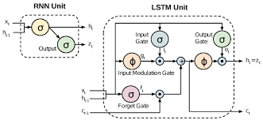
LSTM is an extension of the previously famous RNN (Recurrent Neural Network). In addition to RNN, LSTMs also have memory over the long run.
It comprises of 3 gates namely input gate, output gate and forget gate.
The forget gate is used to forget features that have little value or weight. As the algorithm keeps running, it learns what is important and what is not by assigning weights accordingly. It will help in making relationships on the large corpus of data as the news dataset keep increasing in real-world scenarios.
Unlike the interconnected neural networks, they have looped neurons.

Slide 28
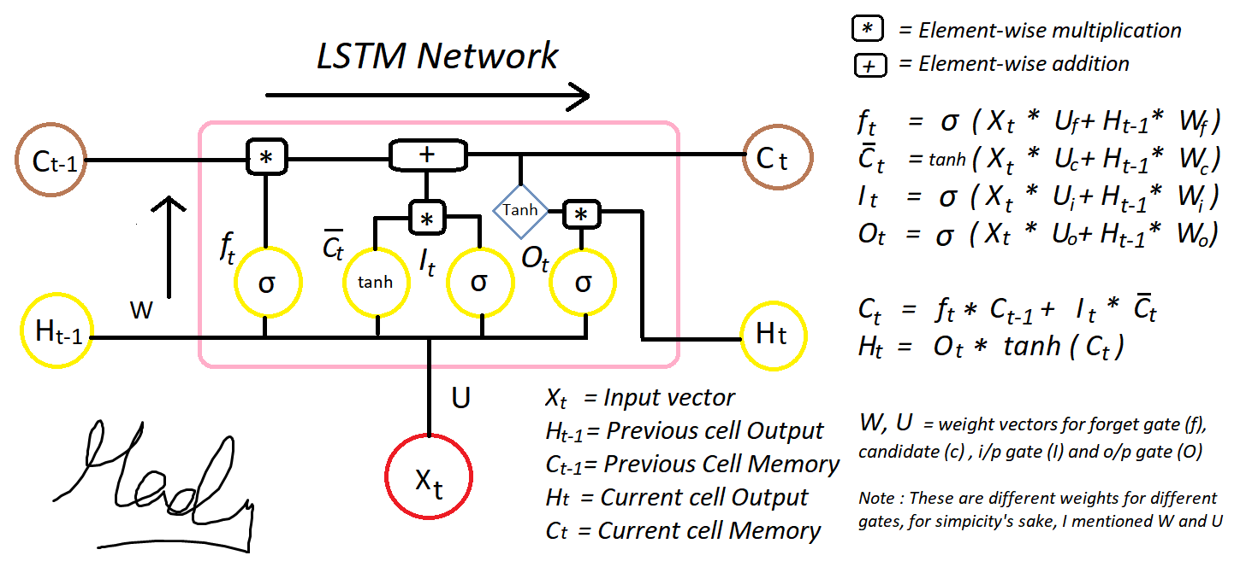
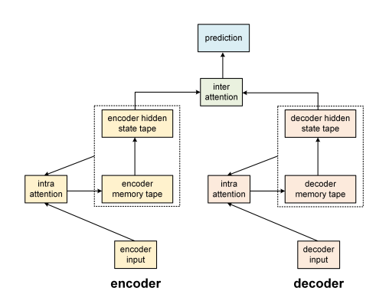

Slide 29
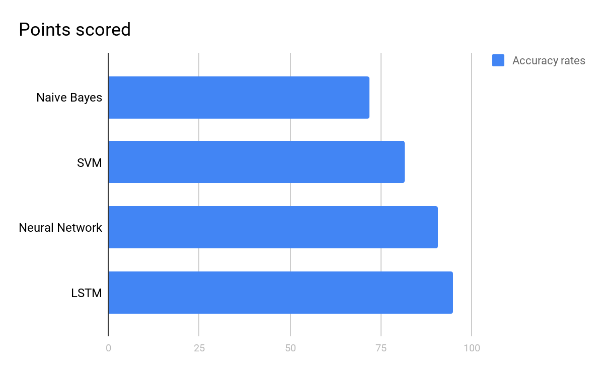
Models | Accuracy rates
Naive Bayes | 71.84%
SVM | 87.37%
Neural Network | 90.47%
LSTM | 99.7%

Slide 30

NOVELTY
Novelty of 'Fake News Detection' lies in its basic theme and essence, that is finding the truth.
The art of fact finding , analysing the news through means of logistics and algorithms and ultimately putting out the truth with full facts.
It's novelty also lies in the idea of serving the social obligations and public at large by throwing some light on the path of truth for those blinded and misguided by the plethora of fake news.

Slide 31
-: REAL TIME USAGE :-
The majority of the implementations to detect fake news comes in the form of a browser add-on. For example,
The bs-detector (The Self Agency, 2016) flags content in social media in different categories such as clickbait, bias, conspiracy theory and junk science.To make this evaluation, the add-on uses Open Sources 3 which is a curated list of dubious websites.
A more advanced example is the Fake News Detector(Chaves, 2018). This add-on uses machine learning techniques in a ground truth dataset combined with the ”wisdom of the crowd” to be constantly learning and improving the detection of fake news.
An interesting system that also took the shape of an add-on was the one developed by four colleges students during a hackathon at Princeton University (Anant Goel,2017). Their methodology combined two different approaches: the first makes a real-time analysis of the content in user’s feed. The other notifies the user when they are posting or sharing doubtful content. The system is capable of analyzing keywords, recognizes images and verified sources to accurately detect fake content online.

Slide 32
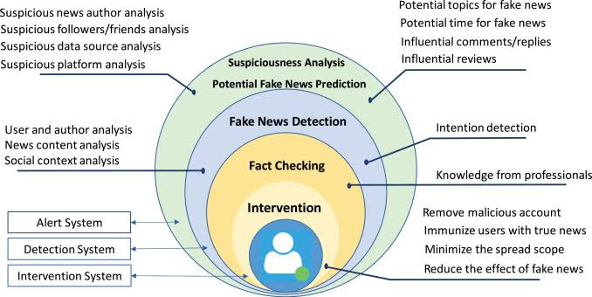


With confidence we can say that new systems are being created with a frequency of more than a dozen a year. Most of them uses the add-on approach, but many are not yet system to be usable by the normal people as they are yet proof of concept prototypes.
The extensive spread of fake news has the potential for extremely negative impacts on individuals and society. Therefore, fake news detection on any platform has recently become an emerging research that is attracting tremendous attention.
These days’ fake news is creating different issues from sarcastic articles to a fabricated news and plan government propaganda in some outlets.
The term 'fake news' became common parlance for the issue, particularly to describe factually incorrect and misleading articles published mostly for the purpose of making money through page views

Slide 33
Why Detection of Fake news is important
Whether you're promoting a product/service, writing an opinion piece or reporting on a news story, it's vital to get all the facts right. A single mistake, no matter how small, could result in anything from losing your customers' trust to becoming the target of an internet backlash or even legal repercussions.
Some produce fake news just for fun, or like trollers who try to humiliate other people. But while doing so, they don’t see the harm that is caused to the victim. The people reacting to the fake news and then the action caused by them to the victim is dangerous.
Fake news and other wrong information can spread exponentially.
Fake news can hurt us, and a lot of other people. Purveyors of fake and misleading medical advice like Mercola.com and NaturalNews.com help perpetuate myths like HIV and AIDS aren't related, or that vaccines cause autism. These sites are heavily visited and their lies are dangerous.
Fake news destroys the credibility. If the arguments are built on bad or misleading information, it would be difficult for the people to trust.

Slide 34


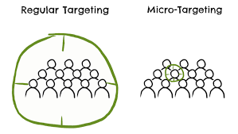

Who spreads fake news?
Bots
Bots
People
Microtargeting
Online Trolls
In addition to the billions of human beings using social media, there are also millions of robots, or bots, residing within. Bots help to propagate fake news and inflate the apparent popularity of fake news on social media.
While bots spread a lot of fake news, the majority of fake news re-transmissions is committed by real people
Many of the trackers come from companies that collect and analyze your web usage in order to personalize ads. Take Facebook, for example. Many websites other than Facebook include Facebook’s like button on them.
Trolls, in this context, are humans who hold accounts on social media platforms, more or less for one purpose: To generate comments that argue with people, insult and name-call other users and public figures

Slide 35
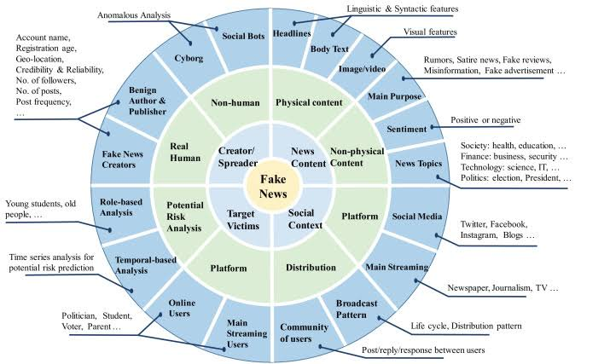

Slide 36



HARDWARE & SOFTWARE REQUIREMENTS
HARDWARE REQUIREMENT -
WINDOWS/MACOS BASED PERSONAL COMPUTER.
SOFTWARE REQUIREMENTS -
Anaconda Jupyter Notebook
Python
numpy
pandas
itertools
matplotlib
sklearn

Slide 37
OVERALL SYSTEM ARCHITECTURE DIAGRAM
NEWS ARTICLES DATASET
PRE-PROCESS THE DATA
FEATURE EXTRACTION
FAKE NEWS
NEWS CLASSIFIER
TRAINING THE MODEL
REAL NEWS

Slide 38
References
https://www.researchgate.net/publication/334192809_A_Study_on_Fake_News_Detection_Using_Naive_Bayes_SVM_Neural_Networks_and_LSTM
https://scikit-learn.org/stable/modules/naive_bayes.html
introduction-to-support-vector-machines-svm
https://www.kdd.org/exploration_files/19-1-Article2.pdf
https://towardsdatascience.com/introduction-to-na%C3%AFve-bayes-classifier-fa59e3e24aaf
https://www.pantechsolutions.net/fake-news-detection-using-machine-learning
https://arxiv.org/pdf/1812.00315.pdf
https://www.cits.ucsb.edu/fake-news/spread#spread-microtargeting
https://www.aclweb.org/anthology/D16-1053.pdf
https://butlercc.libguides.com/fakenews
FakeDetector: : Effective Fake News Detection with Deep Diffusive Neural Network (Research paper)

Slide 39

REVIEW 0 UPDATES
FINAL ALGORITHM CHOSEN AND WHY?
We chose LSTM algorithm, an extension of RNN as it has the highest accuracy rate compared to other algorithms.
BASIC LOGIC USED
Further explained in ppt.
DATASET REQUIREMENTS
We collect news and put the data in an excel sheet. With the help of the already classified data in csv we train and test the model.

Slide 40
FIRST REVIEW

Slide 41

LITERATURE REVIEW
By conducting a systematic literature review, we identify the main approaches currently available to identify fake news and how these approaches can be applied in different situations. Social networks are stepping up in using digital fake news detection tools and educating the public towards spotting fake news.
Facebook uses machine learning algorithms to identify false or sensational claims used in advertising for alternative cures for COVID-19, they place potential fake news articles lower in the news feed, and they provide users with tips on how to identify fake news themselves.
Another tool, developed to identify fake news on Twitter, has a component called the Twitter Crawler which collects and stores tweets in a database. When a Twitter user wants to check the accuracy of the news found they can copy a link into this application after which the link will be processed for fake news detection. This process is built on an algorithm called the NER (Named Entity Recognition).

Slide 42
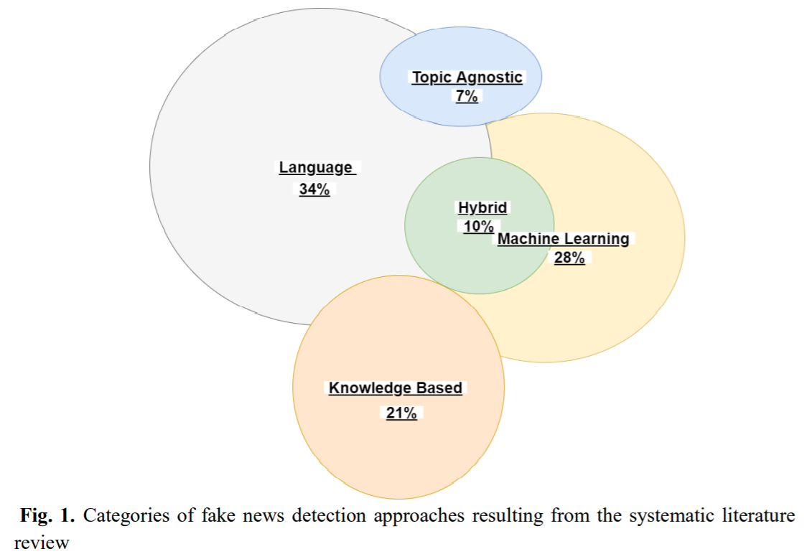
Categories of fake news detection approaches resulting from the systematic literature review
Language Approach:-
This approach focuses on the use of linguistics by a human or software program to detect fake news. Most of the people responsible for the spread of fake news have control over what their story is about, but they can often be exposed through the style of their language. The approach considers all the words in a sentence and letters in a word, how they are structured and how it fits together in a paragraph. The focus is therefore on grammar and syntax. There are currently three main methods that contribute to the language approach:
Bag of Words (BOW)
Semantic Analysis
Deep Syntax
Topic-Agnostic Approach:-
This category of approaches detect fake news by not considering the content of articles but rather topic-agnostic features. The approach uses linguistic features and web markup capabilities to identify fake news. Some examples of topic-agnostic features are:
A large number of advertisements.
Longer headlines with eye-catching phrases.
Different text patterns from mainstream news to induce emotive catching phrases.
Presence of an author name.
Knowledge Based Approach:-
Microblogging platforms such as Twitter causes small pieces of false information to spread very quickly to a large number of people. The knowledge-based approach aims at using sources that are external to verify if the news is fake or real and to identify the news before the spread thereof becomes quicker. There are three main categories :
(1) Expert Oriented Fact Checking : Requires professionals to evaluate the accuracy of the news manually through research and other studies on the specific claim. Fact checking is the process of assigning certainty to a specific element by comparing the accuracy of the text to another which has previously been fact checked.
(2) Computational Oriented Fact Checking : Administer users with an automated fact-checking process that is able to identify if a specific piece of news is true or false. ClaimBuster is an example.
(3) Crowd Sourcing Oriented Fact Checking : gives the opportunity for a group of people to make a collective decision through examining the accuracy of news. The accuracy of the news is completely based on the wisdom of the crowd. Kiskkit is an example.
Machine Learning Approach:-
Machine learning algorithms can be used to identify fake news. This is achieved through using different types of training datasets to refine the algorithms. Datasets enables computer scientists to develop new machine learning approaches and techniques. Datasets are used to train the algorithms to identify fake news. A machine learning approach called the rumor identification framework has been developed that legitimizes signals of ambiguous posts so that a person can easily iden-
tify fake news. The framework will alert people of posts that might be fake. The framework is built to combat fake tweets on Twitter and focuses on four main areas:
the metadata of tweets
the source of the tweet
the date and area of the tweet
where and when the tweet was developed
By studying these four parts of the tweet the framework can be implemented to check the accuracy of the information and to separate the real from the fake. Supporting this framework, the spread of gossip is collected to create datasets with the use of a Twitter Streaming API.
Hybrid Approach:-
A hybrid model which helps to identify fake news on social media through using a combination of human and machine learning to help identify fake news. To make the hybrid model effective it combines social media news with machine learning and a network approach. A hybrid model called CSI (capture, score, integrate) has been developed and functions on the main elements:
(1) capture - the process of extracting representations of articles by using a Recurrent Neutral Network (RNN)
(2) Score – to create a score and representation vector
(3) Integrate – to integrate the outputs of the capture and score resulting in a vector used for classification.

Slide 43
MODULE DESCRIPTION
Cleaning the original data by removing the stop-words and counting unique words
Importing and installing datasets and libraries
Assigning 0 and 1 values to fake and true news and creating a table
Prepare the data by performing tokenization and padding
Take data and divide it into training and testing
Visualising the cleaned data
Using LSTM Networks as an extension to neural networks
Building a LSTM model and using embedding layer which reduces the usage of variables significantly
Fitting our model to the training data and training the model
Model makes prediction of fake and real news and getting the accuracy of the prediction

Slide 44
MODULE WORK FLOW EXPLANATION
TASK #1: UNDERSTAND THE PROBLEM STATEMENT AND BUSINESS CASE
➢ Right now, we live in a world of mis-information and fake news. The goal of this hands-on project is to detect fake news based on Recurrent Neural
Networks.
➢ Natural language processing (NLP) work by converting word (text) into numbers. • These numbers are then used to train an Al/ML models to make
predictions.
➢ Al/ML-based fake news detector is crucial for companies and media to automatically predict whether circulating news is fake or not.
➢ In this case study, we will analyze thousands of news text to detect if it is fake or not.
TASK #2: IMPORT LIBRARIES AND DATASETS , TASK #3: PERFORM EXPLORATORY DATA ANALYSIS

Slide 45
TASK#4 : Performing data cleaning
Step 1:Download stopwords using nltk.
Step 2: Function that removes stopwords.
Step 3: Applying the function to dataframe.
Step 4: Obtaining the total words in the cleaned dataframe.
Stopwords:
Common words or words that are more commonly used
Like: is, are, we..
Step 5: Obtaining the total number of unique words.
Step 6: Joining the words into a string.

Slide 46
TASK#5 : VISUALISE CLEANED UP DATASET
We need countplot to see how many subjects we have.
Then we plot word cloud for text that is real as well as fake.
To obtain the maximum length of the words, length of maximum document (News)will be needed to create word embeddings.
Word cloud is a powerful visualisation for text data - to see how commonly the word is used.

Slide 47
TASK#6 : Prepare the data by performing tokenization and padding
Prepare data before training LSTM network
Perform tokenization – convert text into bunch of numbers(integers)
Ready to train model
Take data and divide it into training and testing DATA
Perform padding

Slide 48
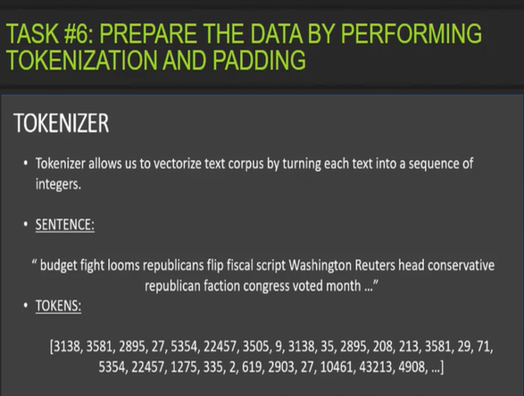
TOKENIZATION
Text information can’t be fed into ML model.
Take the bunch of text and transform/convert it into tokens ( consider them to be bunch of numbers) and train the AI-ML model.

Slide 49
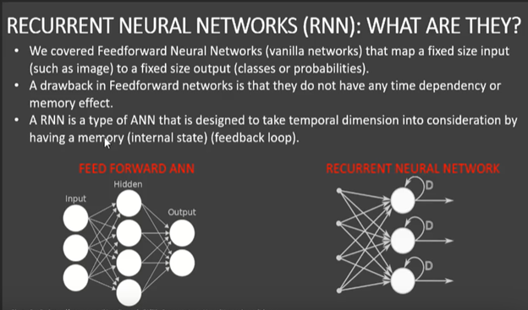
TASK#7 : Understand the intuition behind recurrent neural networks
RNN-output fed back as input
so output not only depends on input, it also depends on what happened in the past- memory effect

Slide 50
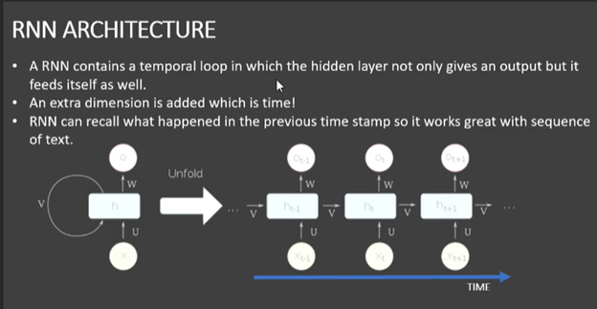
RNN ARCHITECTURE
x- input LAYER
o- output LAYER
h- hidden layer

Slide 51
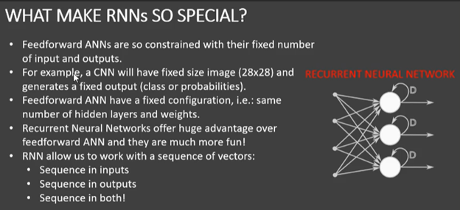
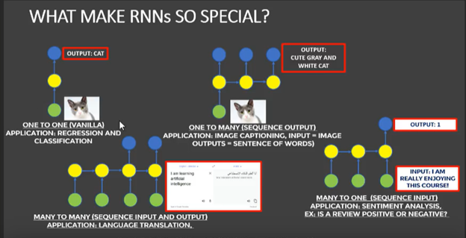
WHAT MAKES RNNS SO SPECIAL ?

Slide 52
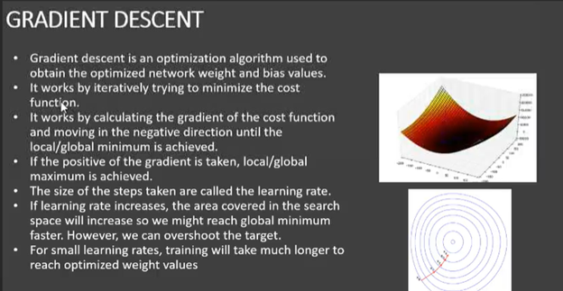
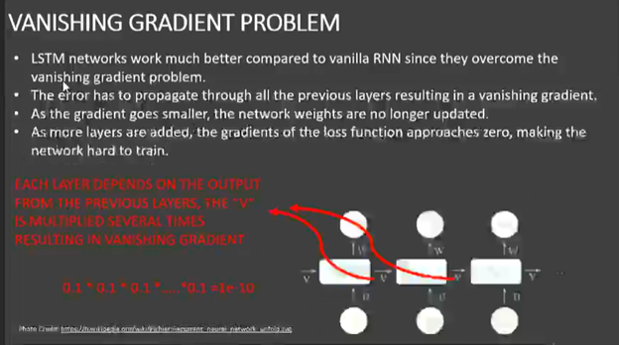
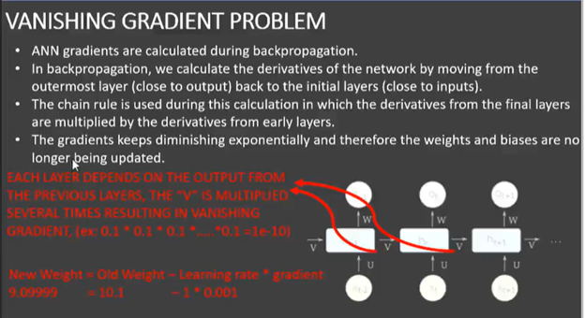
CHALLENGES OF RNN

Slide 53
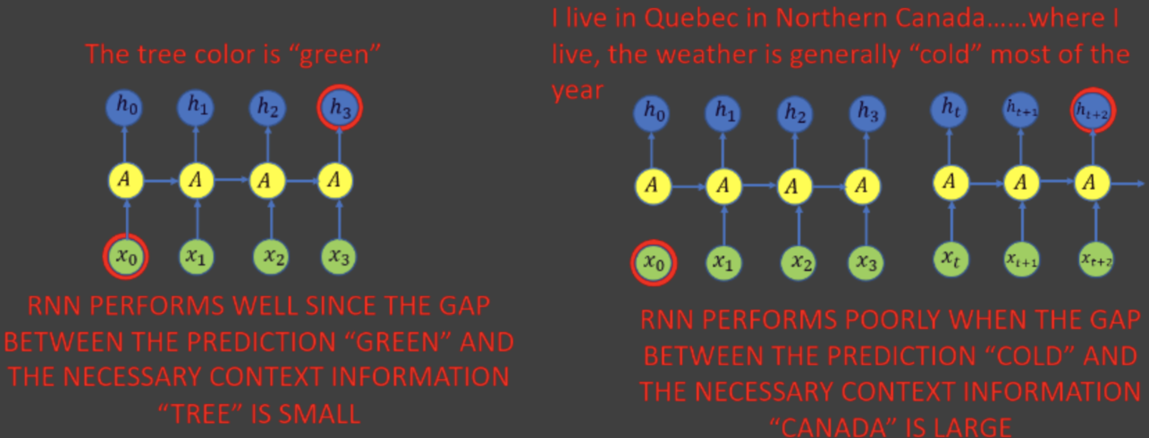
TASK #8: Understand the intuition between LSTM networks
LSTM networks work better compared to vanilla RNN since they overcome vanishing gradient problem.
In practice, RNN failed to establish long term dependencies.
LSTM networks are type of RNN to remember long term network dependencies by default.

Slide 54
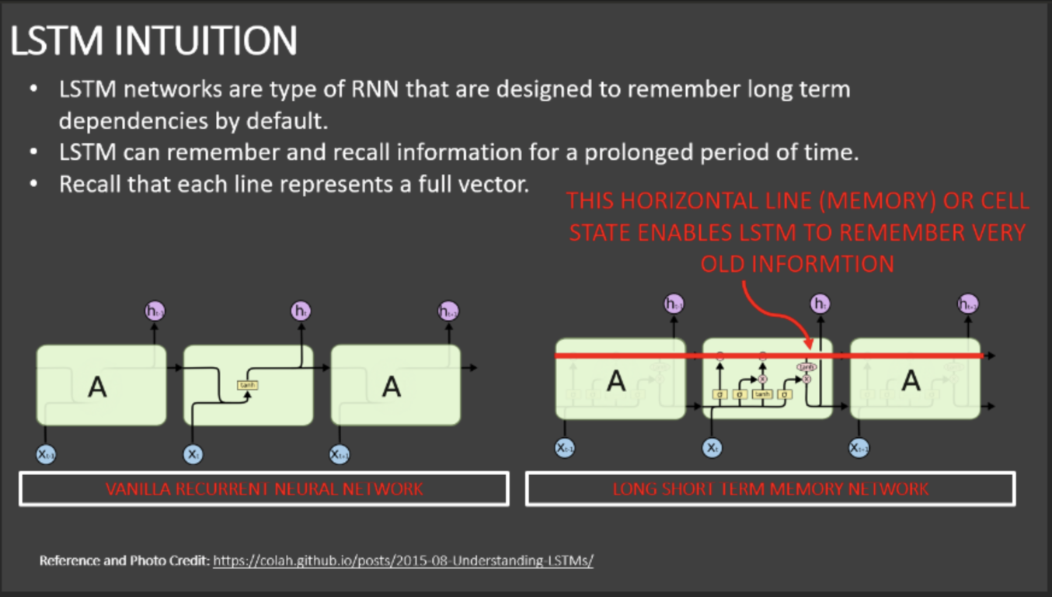
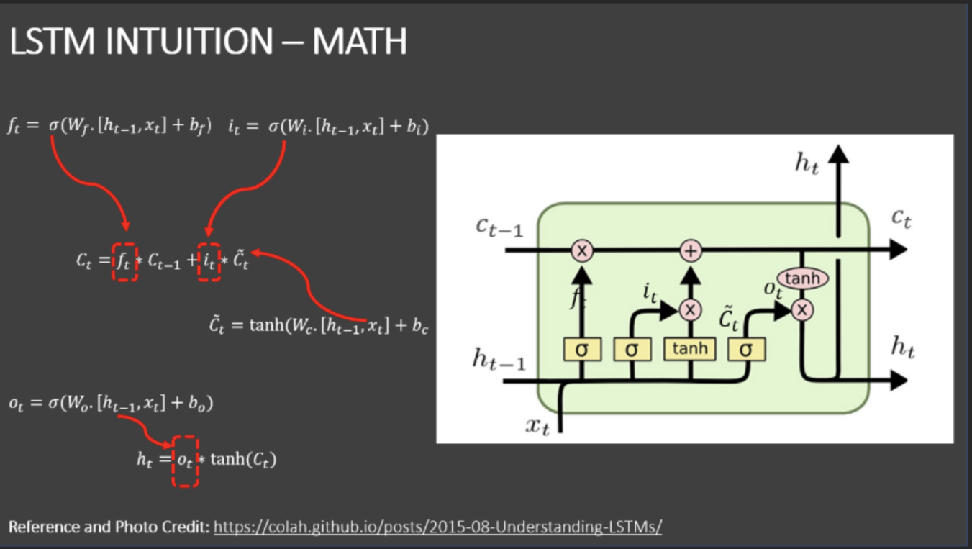
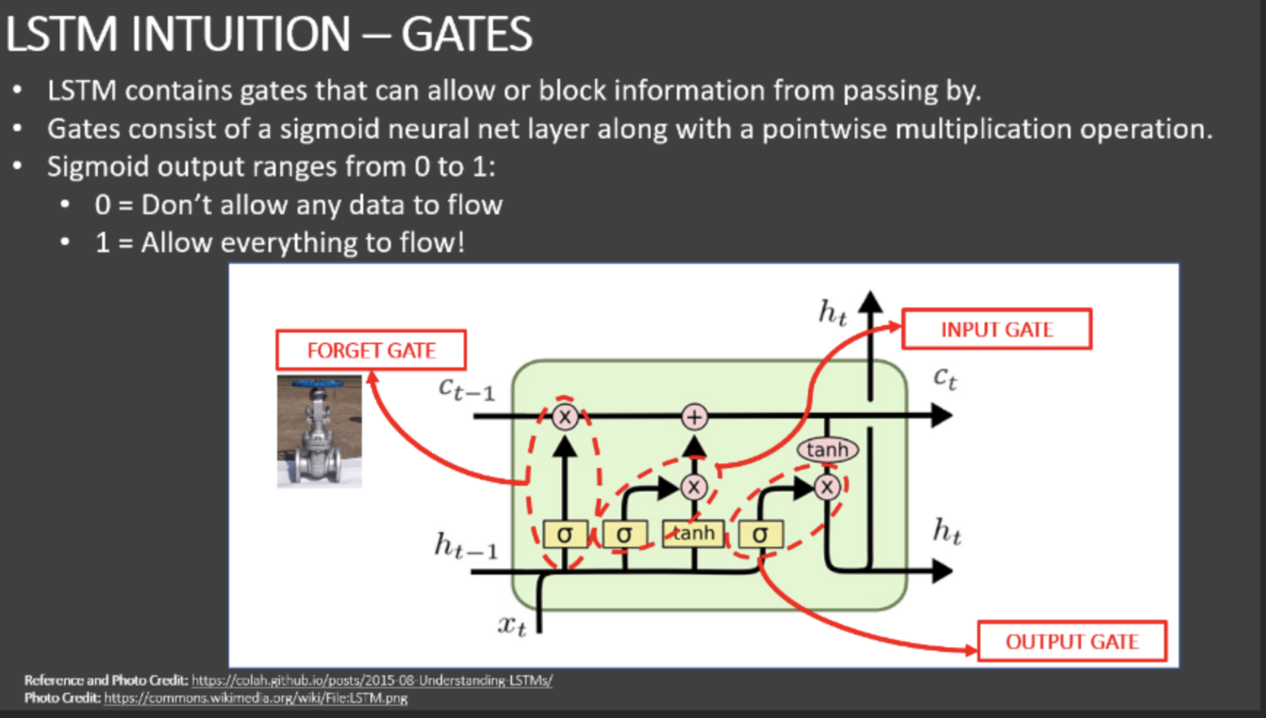
LSTM Intuition
GATES

Slide 55
TASK #9: Build and Train the LSTM Network
Embedding layers learn the low-dimensional continuous representation of input discrete variables.
For example, if we have 100000 unique values in our data then with the help of embedding layer the model can learn a way to represent them in 200 variables.
This in-turn helps subsequent layers learn more effectively with less compute resources.
Testing and training data
We divide the data into training data and testing data.
Testing is the subset of data that the model has never seen before during training and that will happen after the model is trained.
TASK #10: Assess Trained LSTM Model Performance
Model makes prediction.
We calculate and visualize the accuracy of classification of fake news.

Slide 56
TASK #2: IMPORT LIBRARIES AND DATASETS
IMPLEMENTATION AND CODING
!pip install --upgrade tensorflow-gpu 2.0
!pip install plotly
!pip install --upgrade nbformat
!pip install nltk
!pip install spacy
# spaCy is an open-source software library for advanced natural language processing 5
!pip install WordCloud
!pip install gensim
# Gensim is an open-source Library for unsupervised topic modeling and natural lang

Slide 57
import nltk
nltk.download('punkt')
import tensorflow as tf
import pandas as pd
import numpy as np
import matplotlib.pyplot as plt
import seaborn as sns
from wordcloud iport WordCloud, STOPWORDS
import nltk
import re
from nltk.stem import PorterStemmer, WordNetLemmatizer
from nltk.corpus import stopwords
from nltk.tokenize import word_tokenize, sent_tokenize
Import gensim
from gensim.utils import simple_preprocess
from gensim.parsing.preprocessing import STOPWORDS
# import keras
from tensorflow.keras.preprocessing.text import one_hot, Tokenizer from tensorflow.keras.preprocessing.sequence import pad_sequences
from tensorflow.keras.models import Sequential
from tensorflow.keras.layers import Dense, Flatten, Embedding, Input, LSTM, Conv1D, MaxPool1D, Bidirect
from tensorflow.keras.models import Model
from jupyterthemes import jtplot
jtplot.style(theme = 'monokai' , context ='notebook' , ticks=True , grid=false)
# setting the style of the notebook to be monokai theme
#Load the data
df_true = pd.read_csv("True.csv")
df_fake = pd.read_csv("Fake.csv")

Slide 58
TASK #3: PERFORM EXPLORATORY DATA ANALYSIS
# Add a target class column to indicate whether the news is real or fake.
df_true['isfake'] = 0
df_true.head()
df_fake['isfake'] = 1
df_fake.head()
# Concatenate Real and Fake News
df = pd.concat([df true, df fake]).reset index(drop = True)
df
df.drop(columns = ['date'], inplace = True)
# combine title and text together
df['original'] = df['title'] + ' ' + df[*text ]
df.head()
#explore 1st dataset row
df['original'][0]

Slide 59
TASK#4 : Performing data cleaning
#download stopwords so that we we can remove the stopwords that does not add much meaning.
nltk.download("stopwords")
#Obtain additional stopwords from nltk
from nltk.corpus import stopwords
stop_words = stopwords.words('english') #stopwords in english
stop_words.extend(['from', 'subject','re','edu','use'])
# Remove stopwords and remove words with 2 or less characters
# so the token 1) should not belong to stop_words, 2) and the length of word should not be less than 3 characters
def preprocess(text):
result = []
for token in gensim.utils.simple_preprocess(text):
if token not in gensim.parsing.preprocessing.STOPWORDS and len(token) > 3 and token not in stop_words:
result.append(token)
return result

Slide 60
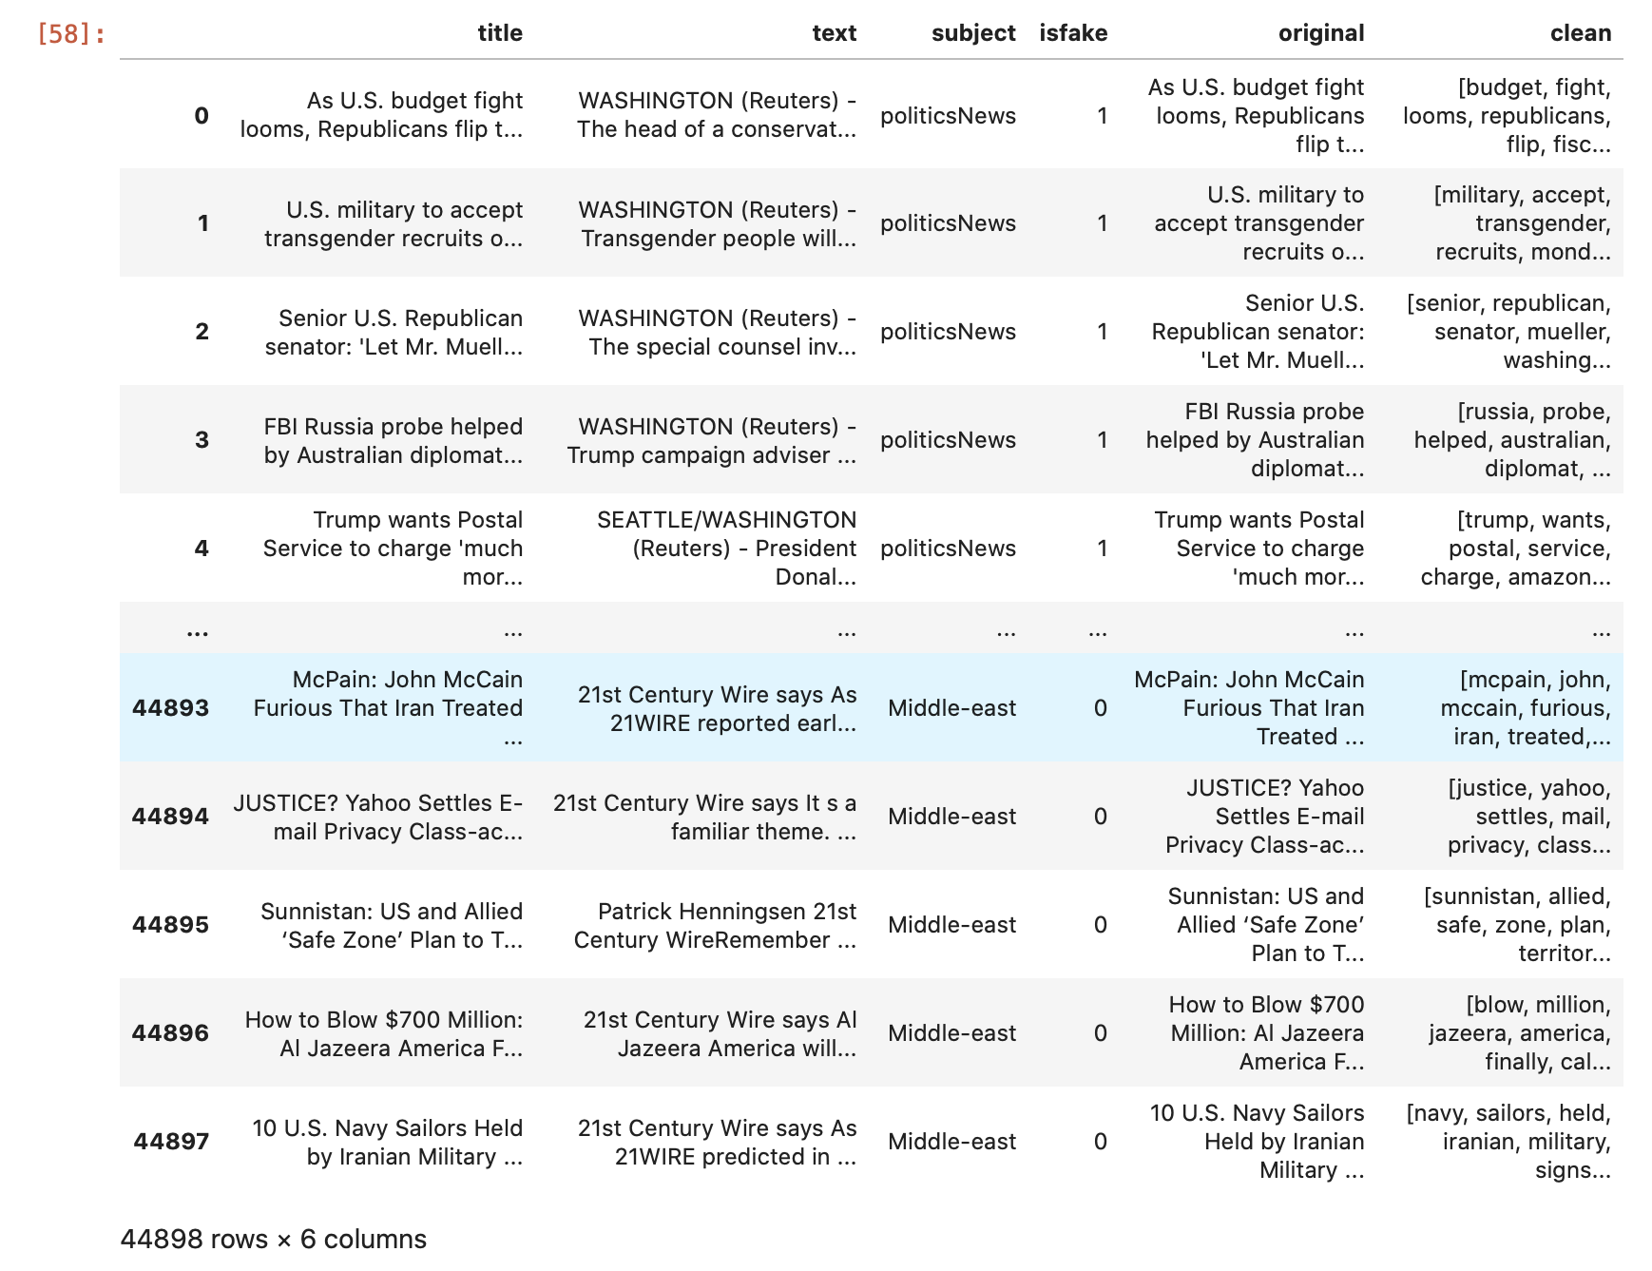

Slide 61
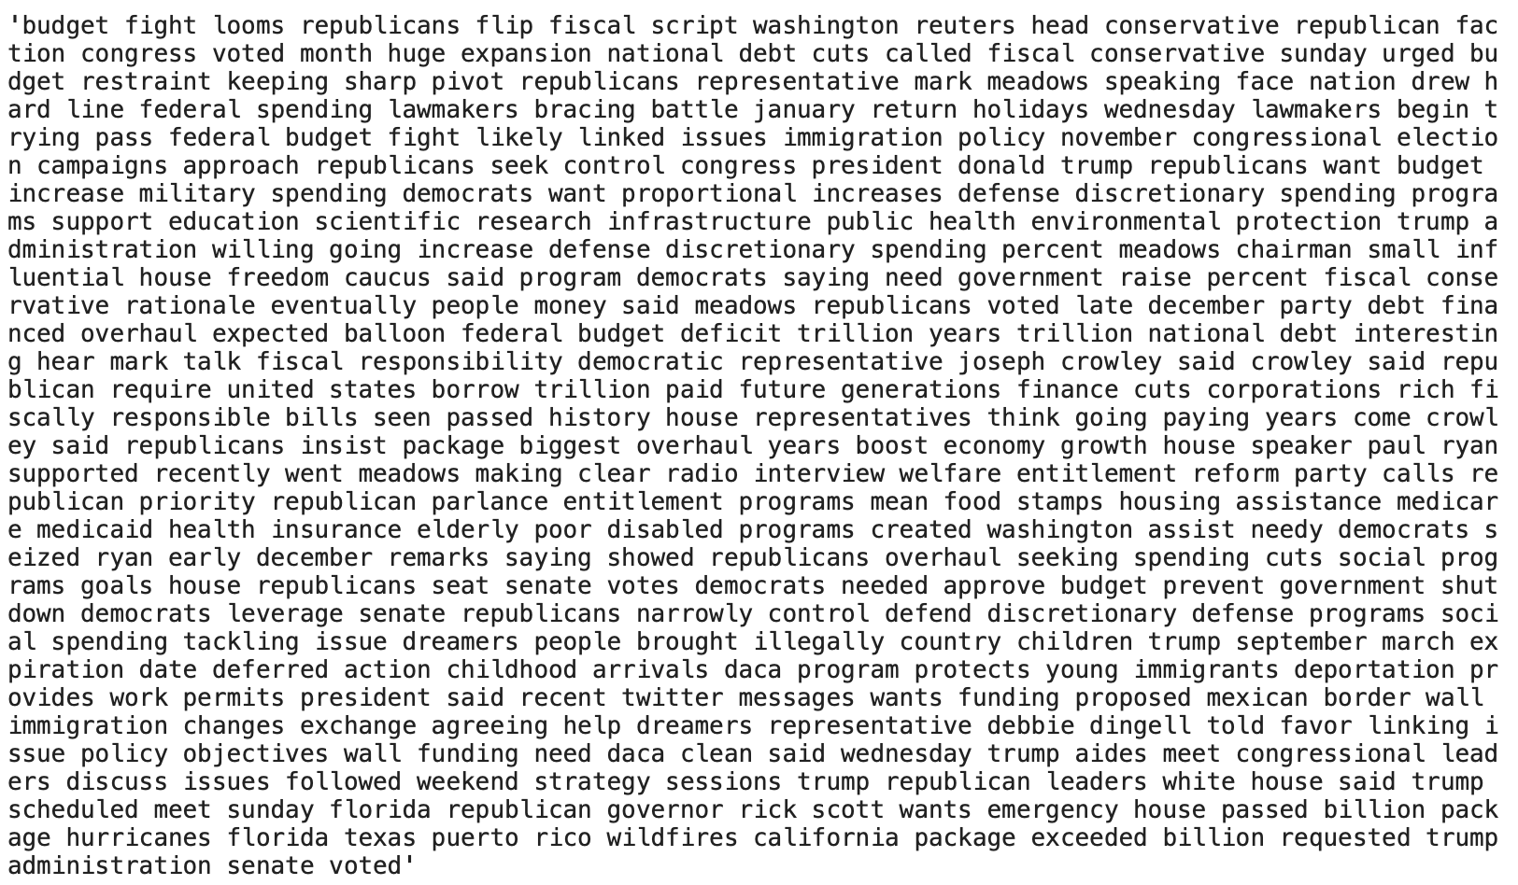

# Apply the function to the dataframe
# clean - will not contain any stopwords
df['clean'] = df['original'].apply(preprocess)
df
# Show original news
df['original'][0]
# Show cleaned up news after removing stopwords
print(df['clean'][0])
df
# Obtain the total words present in the dataset
list_of_words = []

Slide 62
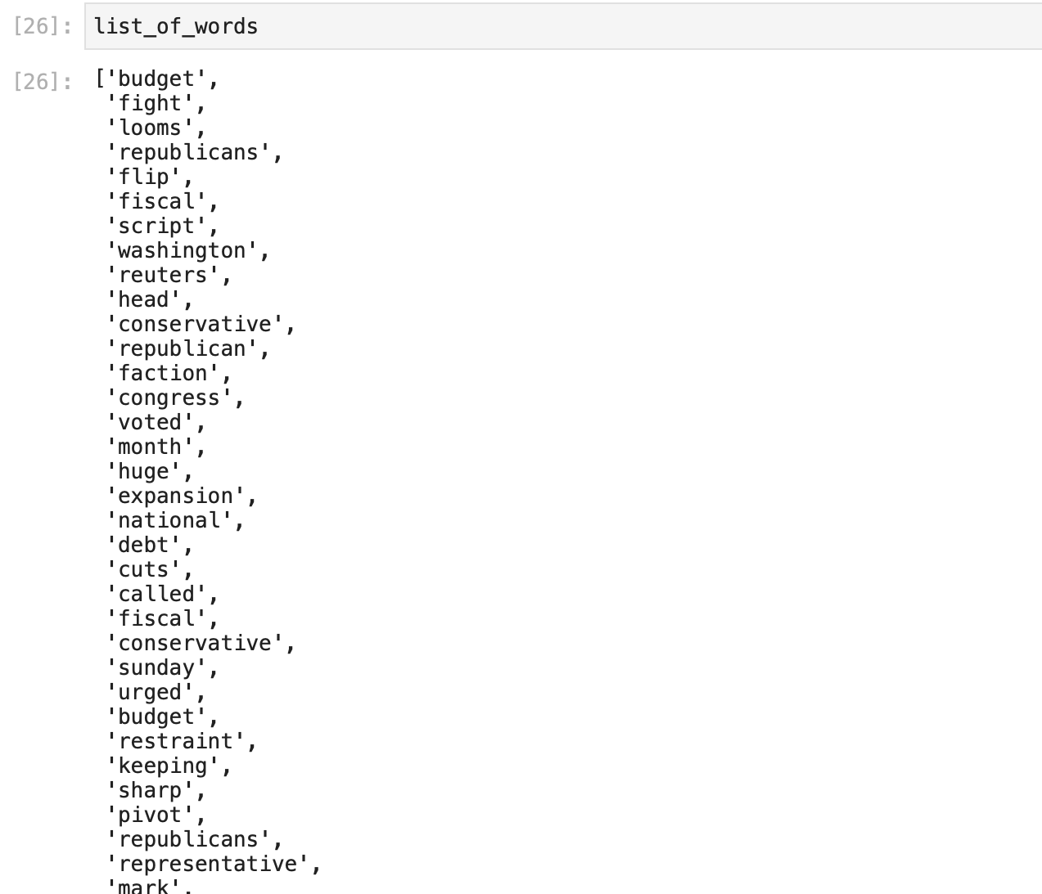
for i in df.clean:
for j in i:
list_of_words.append(j)
list_of_words
len(list_of_words)
# Obtain the total number of unique words
total_words = len(list(set(list_of_words)))
total_words
# join the words into a string
df['clean_joined'] = df['clean'].apply(lambda x: " ".join(x))
df
df['clean_joined'][0]

Slide 63
TASK#5 : VISUALISE CLEANED UP DATASET
# plot the number of samples in 'subject'
# countplot - to see how many subjects we have in countplot
plt.figure(figsize = (8,8))
sns.countplot(y = "subject", data = df)
# word cloud is a powerful visualisation for text data - to see how commonly the word is used
#plot the word cloud for text that is Real
plt.figure(figsize = (20,20))
wc = WordCloud(max_words = 2000, width = 1600, height = 800, stopwords = stop_words).generate(" ".join(df[df.isfake == 1].clean_joined))
plt.inshow(wc, interpolation = 'bilinear')
#plot the word cloud for text that is Fake
plt.figure(figsize = (20,20))
wc = WordCloud(max_words = 2000, width = 1600, height = 800, stopwords = stop_words).generate(" ".join(df[df.isfake == 0].clean_joined))
plt.inshow(wc, interpolation = 'bilinear')
ntlk.word_tokenize(df['clean_joined'][0])

Slide 64
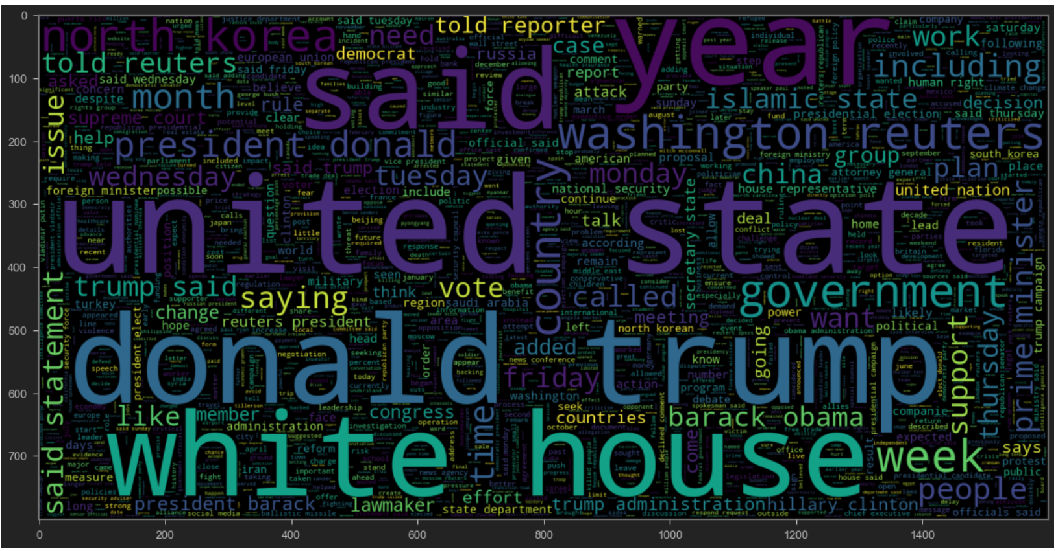
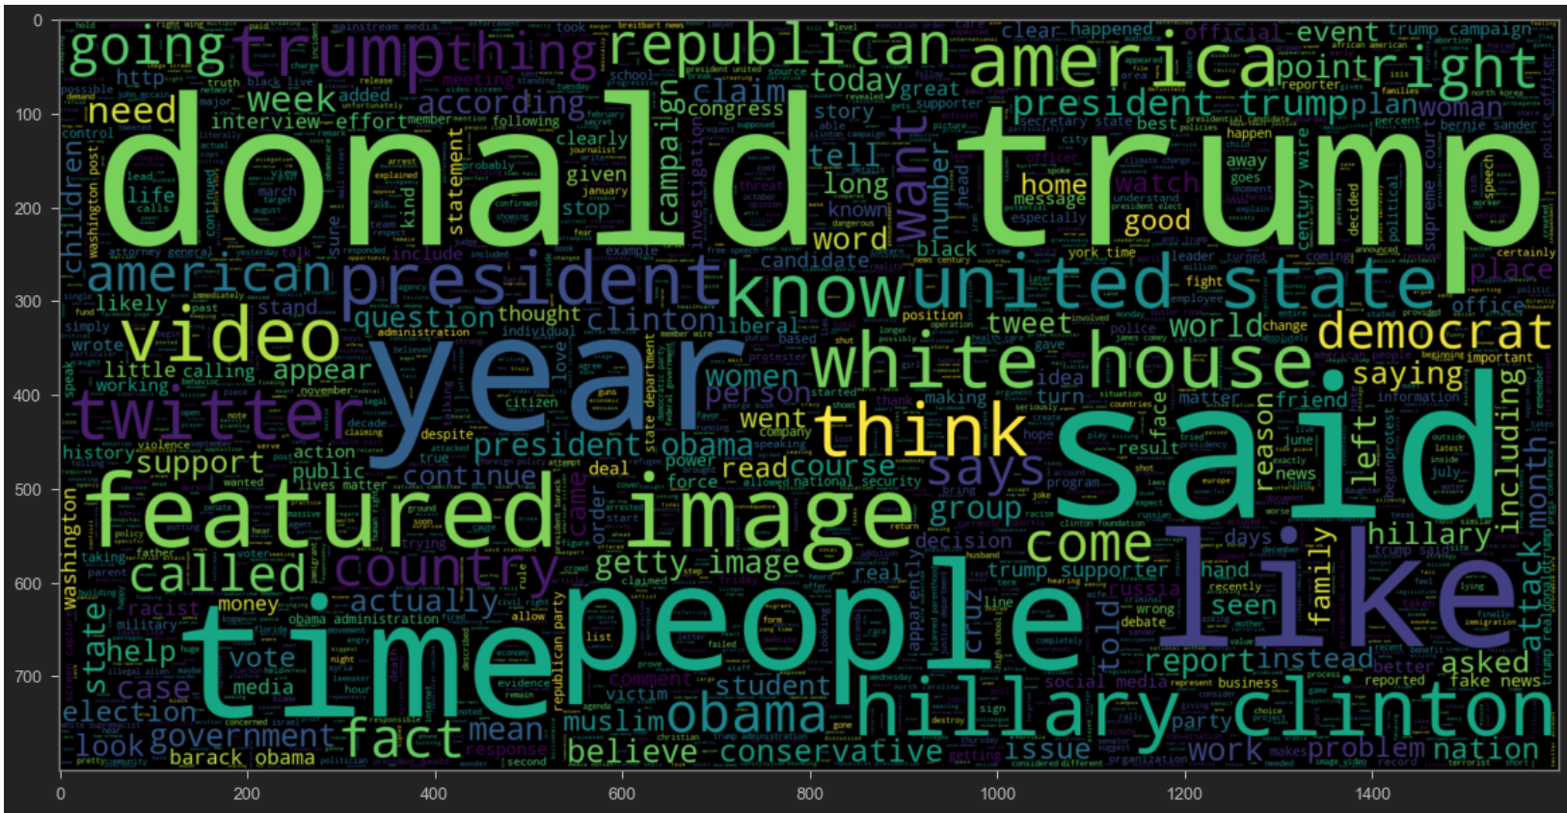
REAL NEWS
FAKE NEWS

Slide 65
# length of maximum document (News) will be needed to create word embeddings
# to obtain the maximum length of the words
maxlen = -1
for doc in df.clean_joined:
tokens = nltk.word_tokenize(doc) # nltk.word_tokenise divides each of the words into tokens- to get unique words
if(maxlen<len(tokens)):
maxlen = len(tokens)
print("The maximum number of words in any document is =", maxlen)
#visualize the distribution of number of words in a text
#to get a dynamic visualization
import plotly.express as px
fig = px.histogram(x = [len(nltk.word_tokenize(x)) for x in df.clean_joined], nbins = 100)
fig.show()

Slide 66
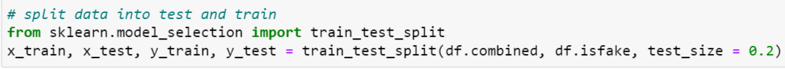
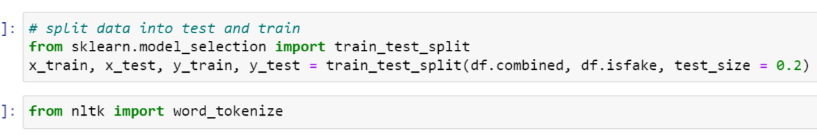
TASK#6 : Prepare the data by performing tokenization and padding
#split data into test and train
#x = df.COMBINED (input to model)
#y = df.isfake (output to model-target)
# test_size = 0.2 means 20% data used for testing and 80% for training
#while training any ML model, the model should generalize and not memorize
#using nltk library to perform tokenization

Slide 67
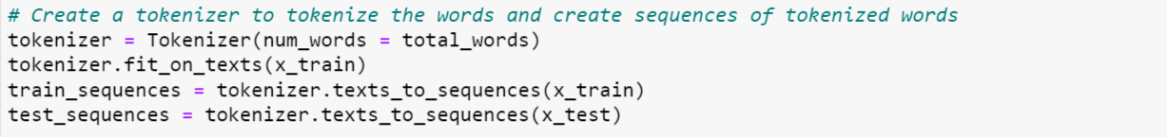
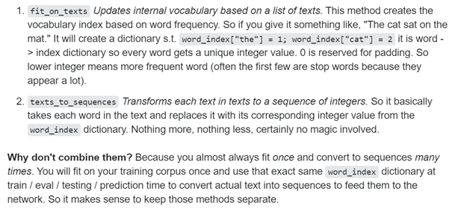
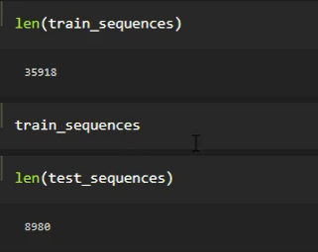
#Create a tokenizer to tokenize the words and create sequences of tokenized words

Slide 68
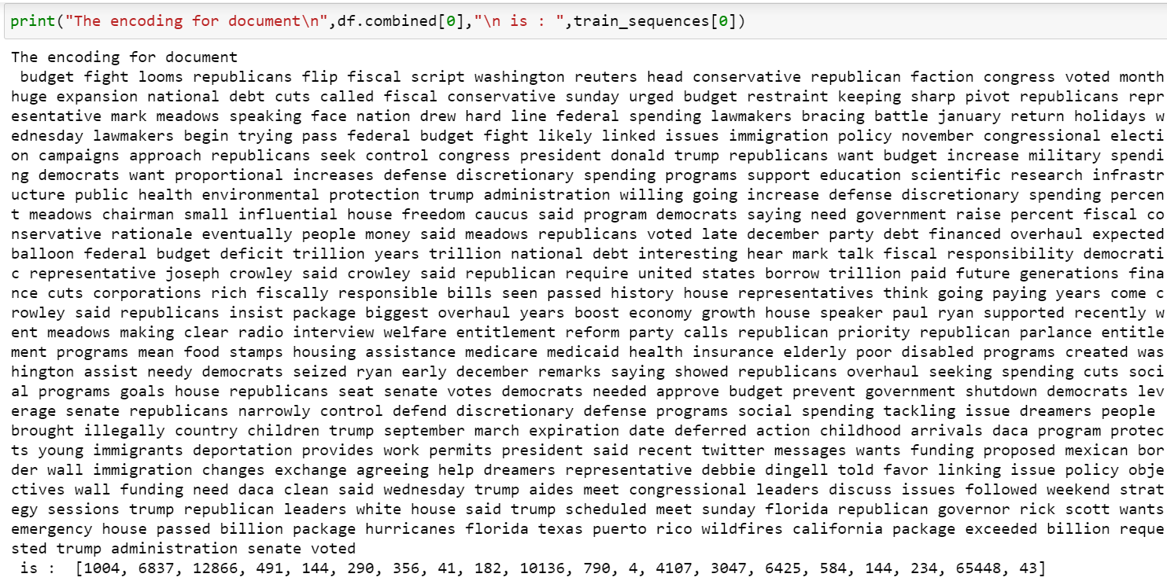
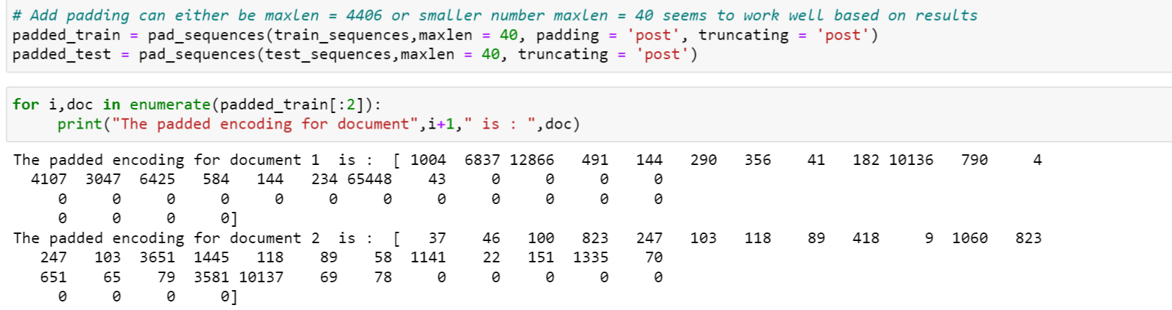
#ensure that all the various news data samples have the same length

Slide 69
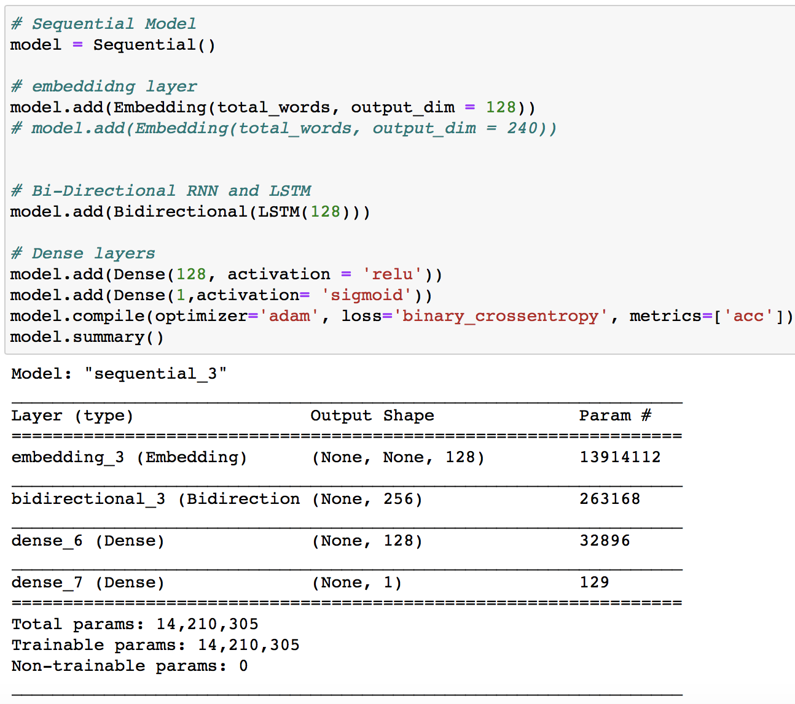
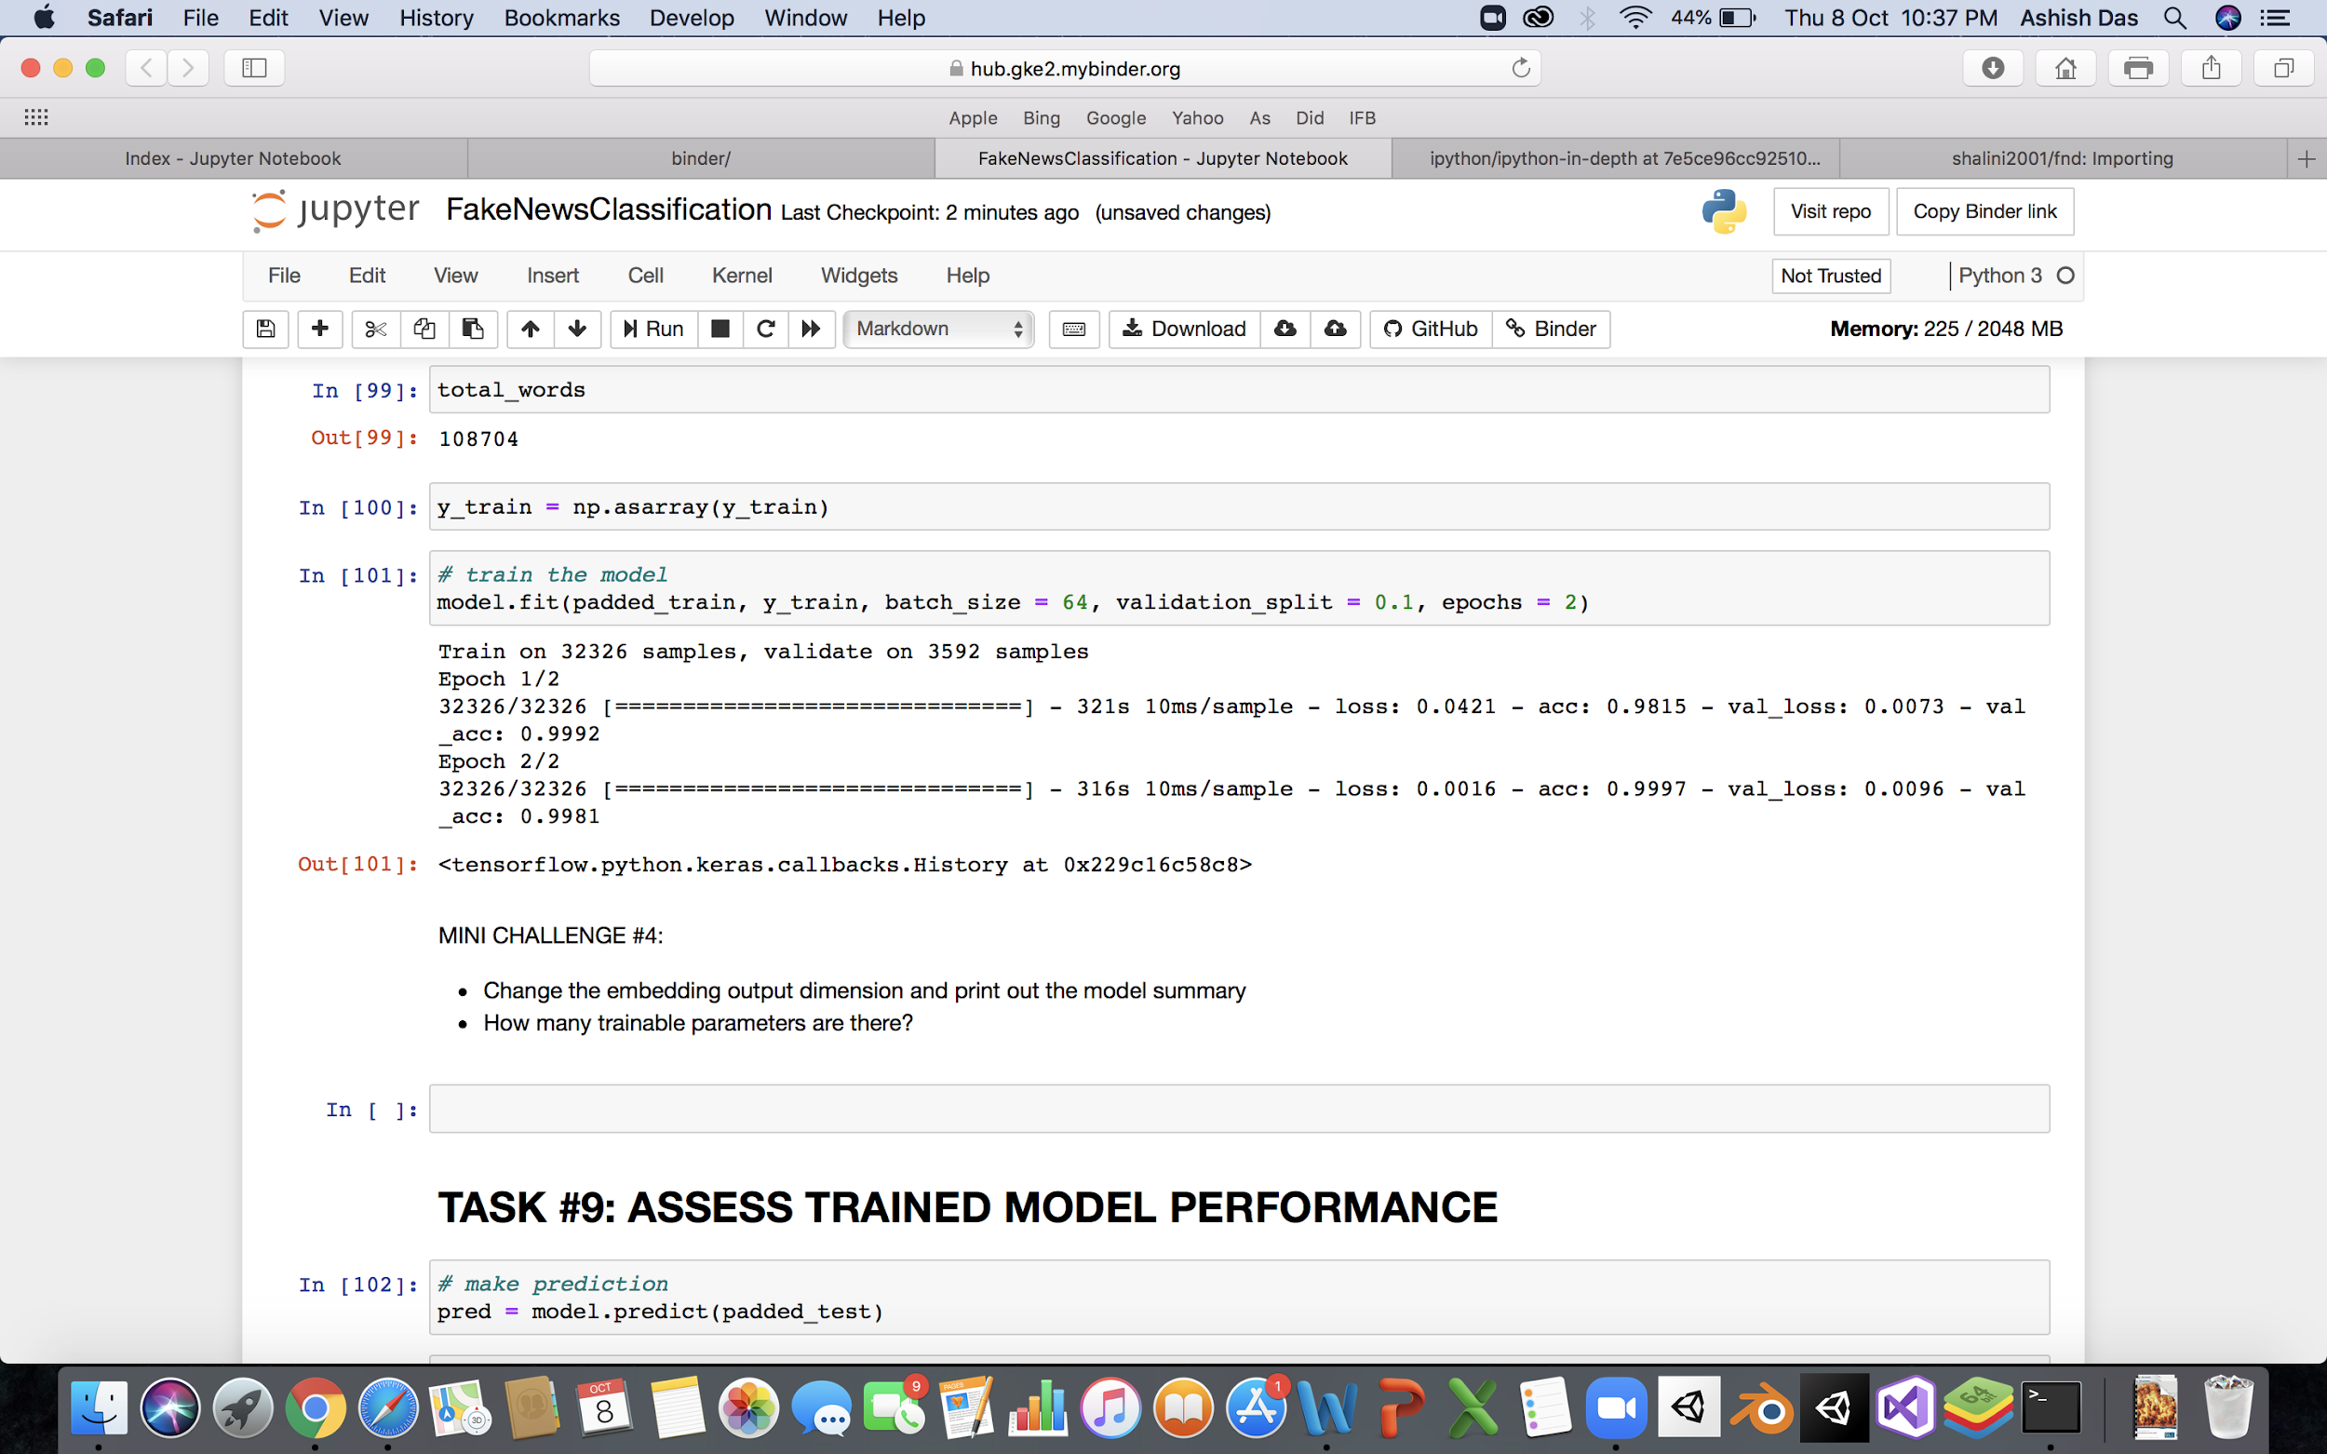
Task: Build and train embedding layer

Slide 70
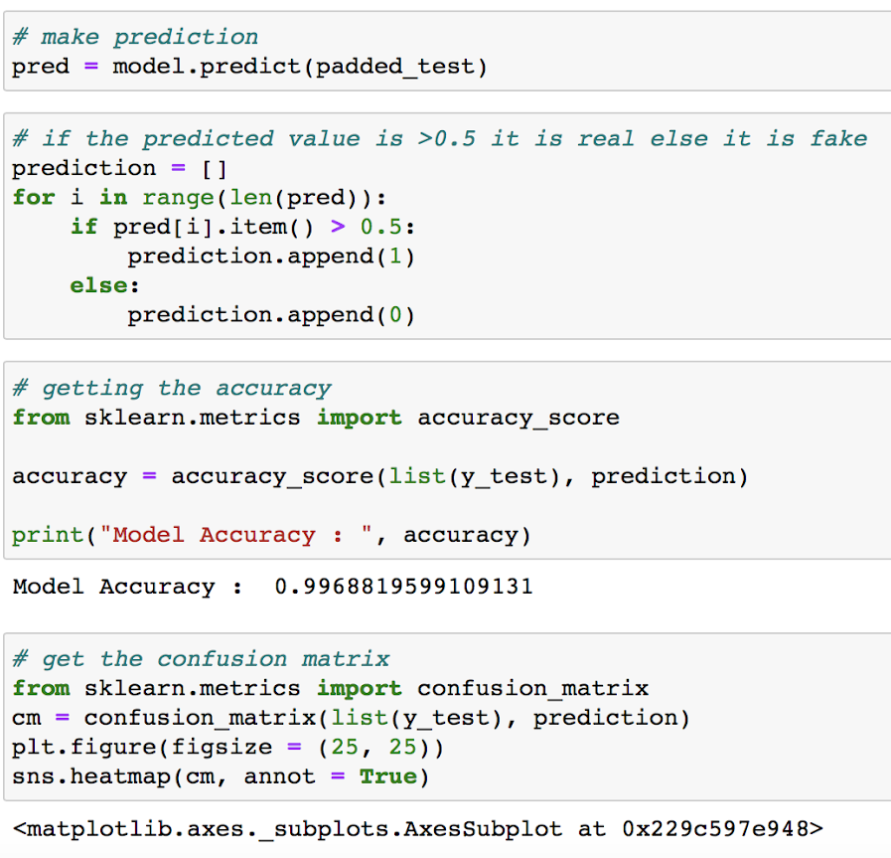

Task: Assess Trained Model Performance

Slide 71
DEMO VIDEO

Slide 72
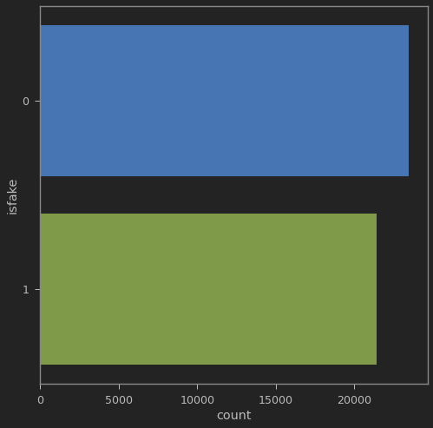
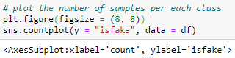
SNAPSHOT OF PROJECT
# We plot the count plot for fake vs. real news

Slide 73
FINAL REVIEW

Slide 74


testing
We had divided the data into both training and testing data. Now we use this testing data to test our model and check whether the news is fake or real.
Below given is a pie that determines the rightly classified data and wrongly classified data:

Slide 75




Result & discussion
By building a Long-Short Term Memory machine learning model, we are able to achieve 99.7% accuracy in correctly detecting the fake and the real news test dataset.
The model takes text dataset files as input and gives the accuracy level as output. The confusion matrix displays the same.

Slide 76

CONCLUSION
We have successfully solved the fake news detection problem by developing a machine learning model using recurrent neural networks (RNN) and long-short term memory (LSTM) algorithms. Our model performs with improved accuracy than the existing ones.

Slide 77
APP PROTOTYPE

Slide 78




Slide 79




Slide 80
THANK YOU

